Slide 1
What is a Mixture?
Grade 4/5

Slide 2
Matter
Everything that surrounds us – can be composed of one thing or many!

Slide 3
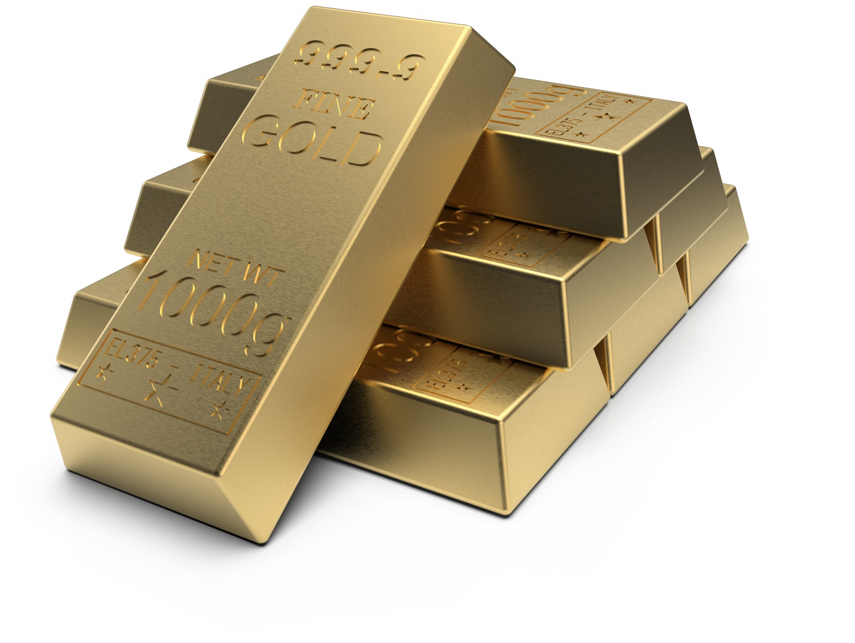
One Substance
One substance means it is NOT a mixture!
Gold is an example of one substance

Slide 4
Mixture
A mixture has two or more substances
They can be HOMOGENEOUS or HETEROGENEOUS
Notes:
What kinds of mixtures do you use every day? How do you know they are mixtures?

Slide 5
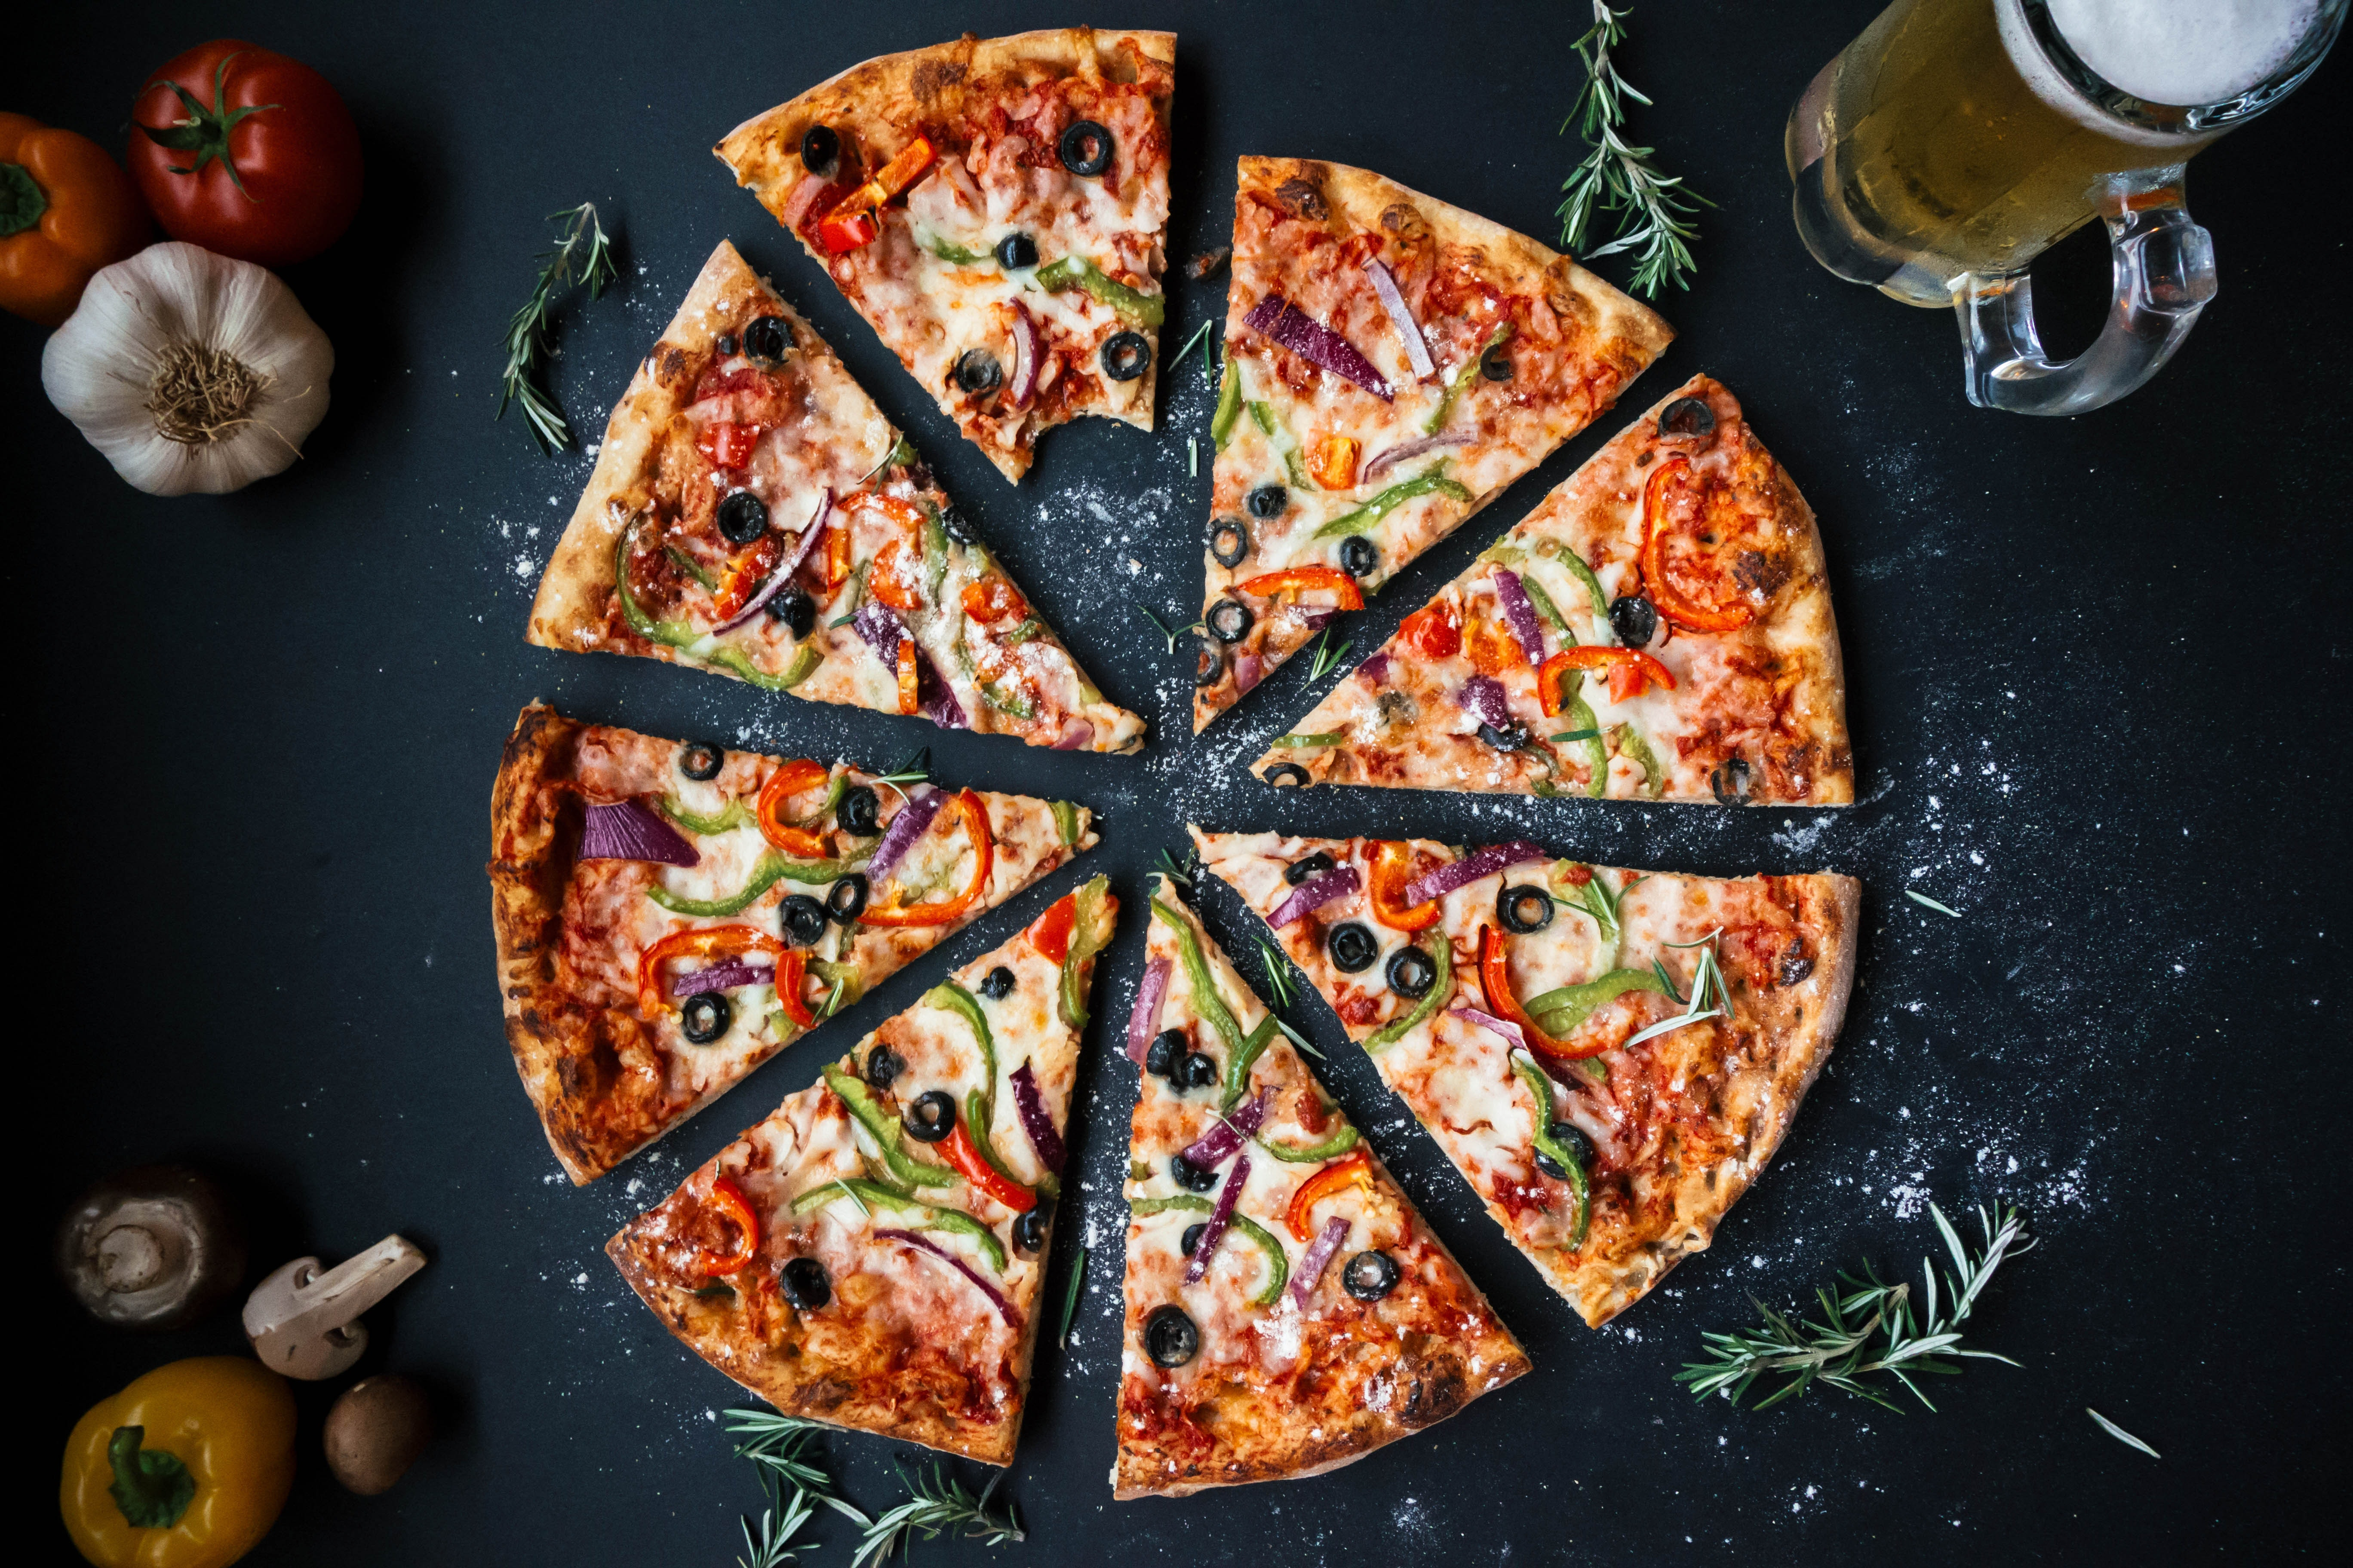
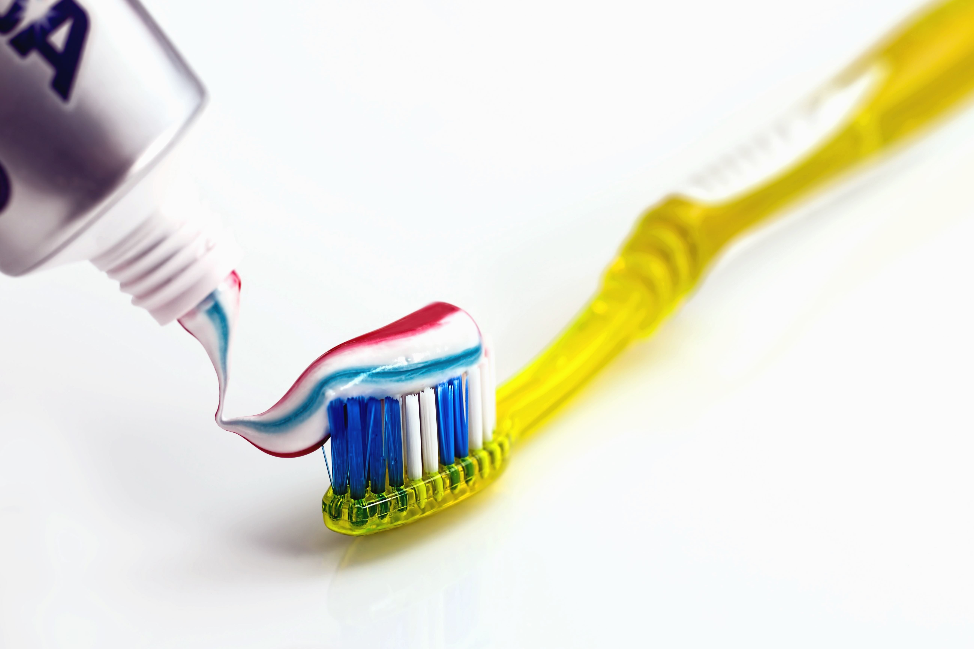
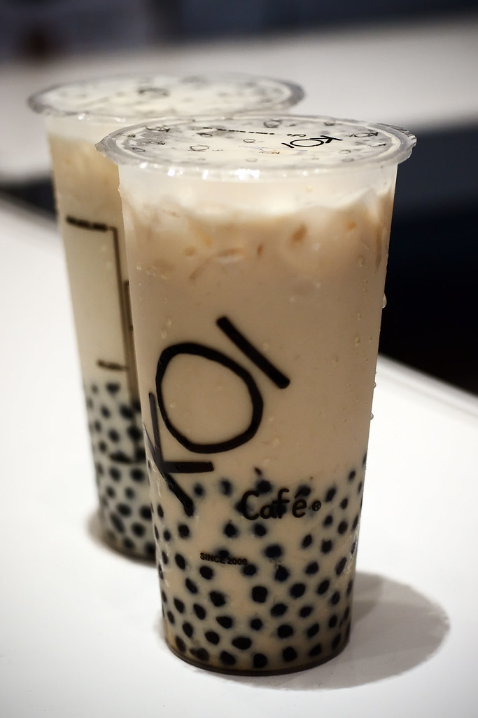
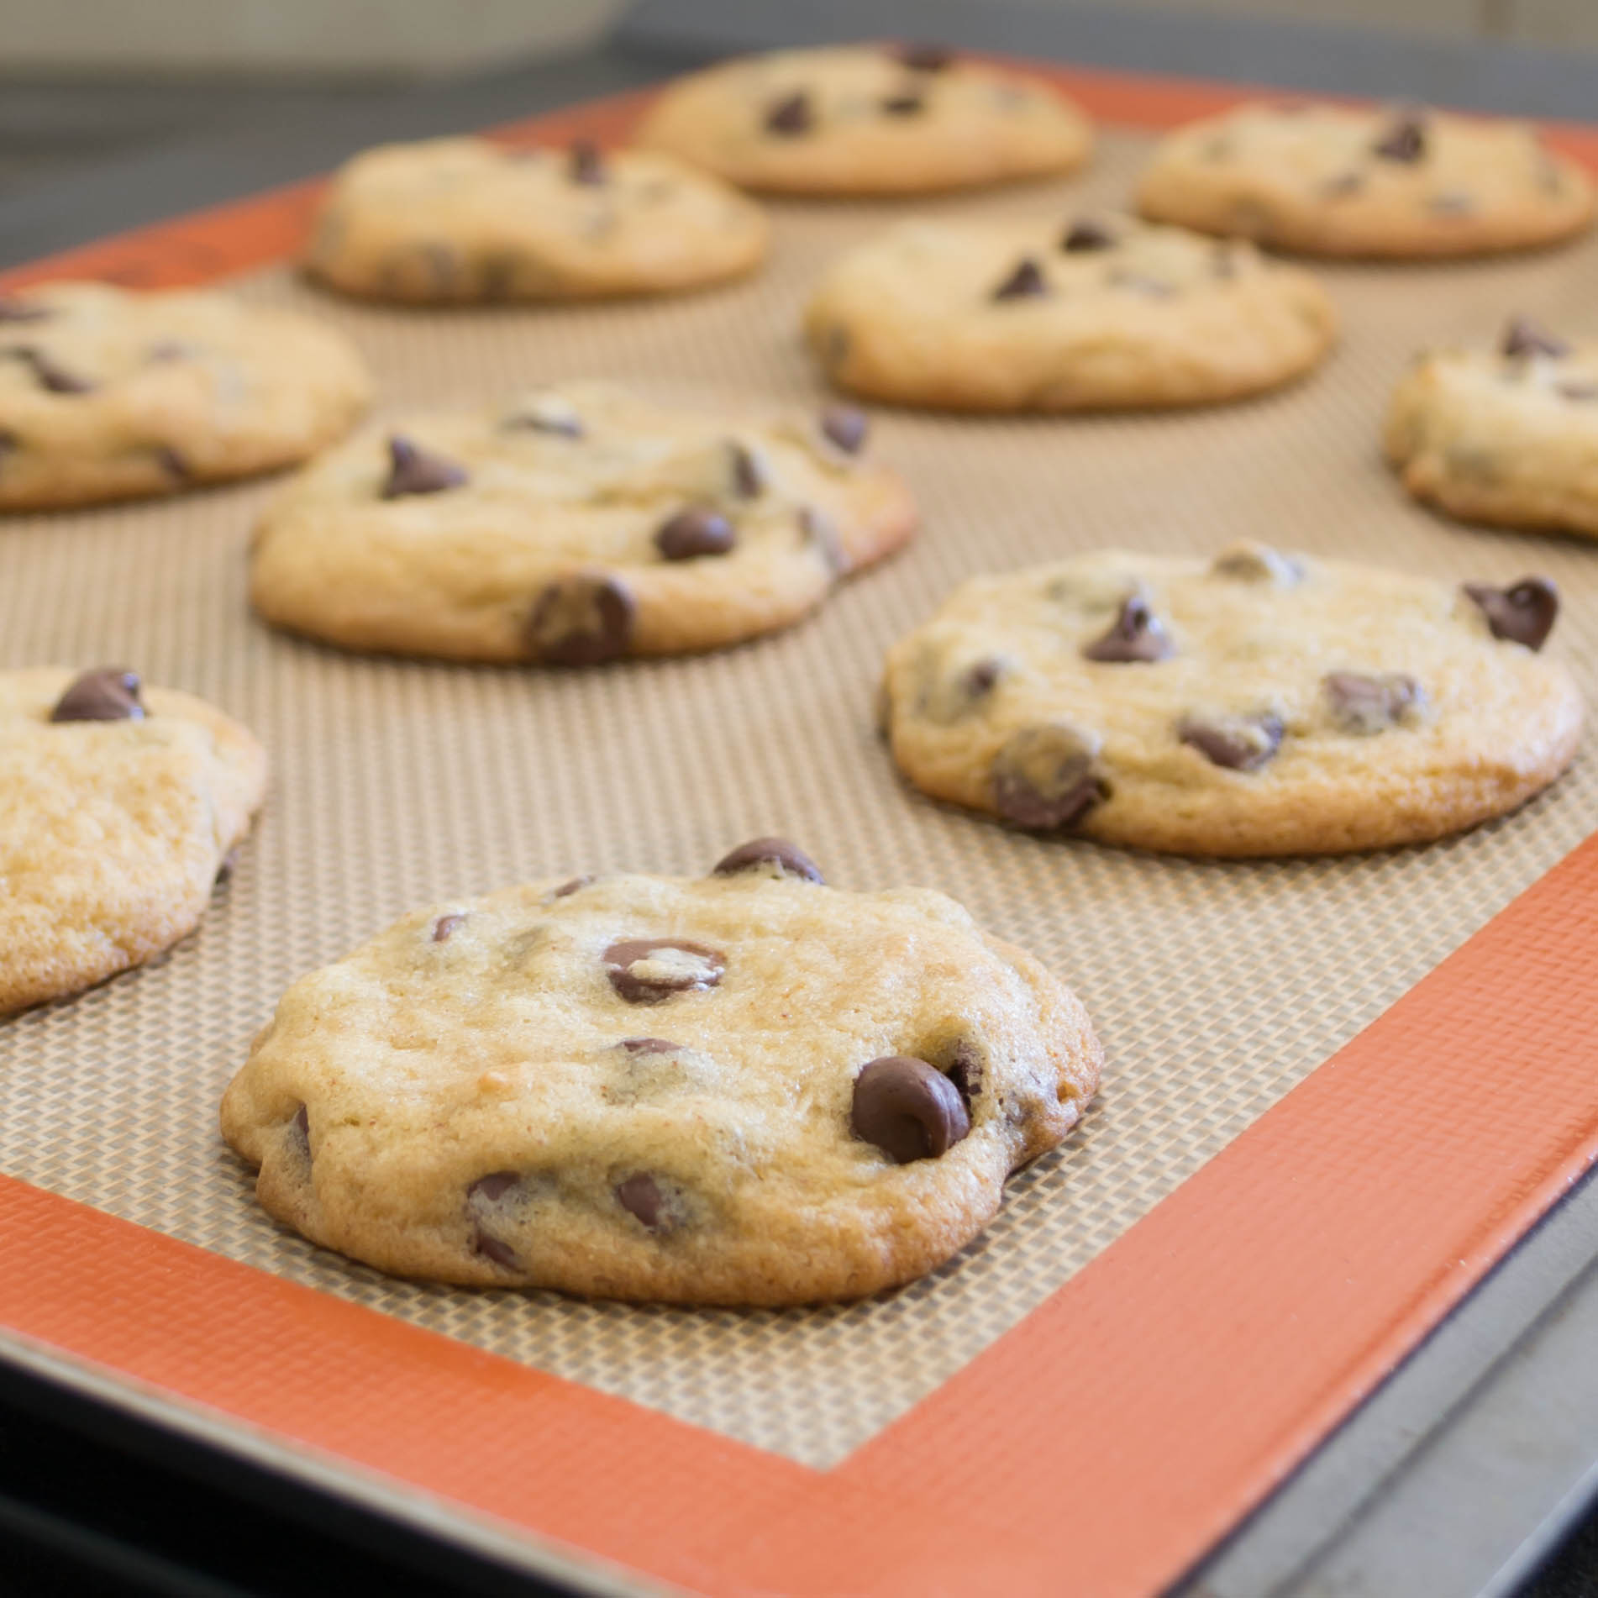
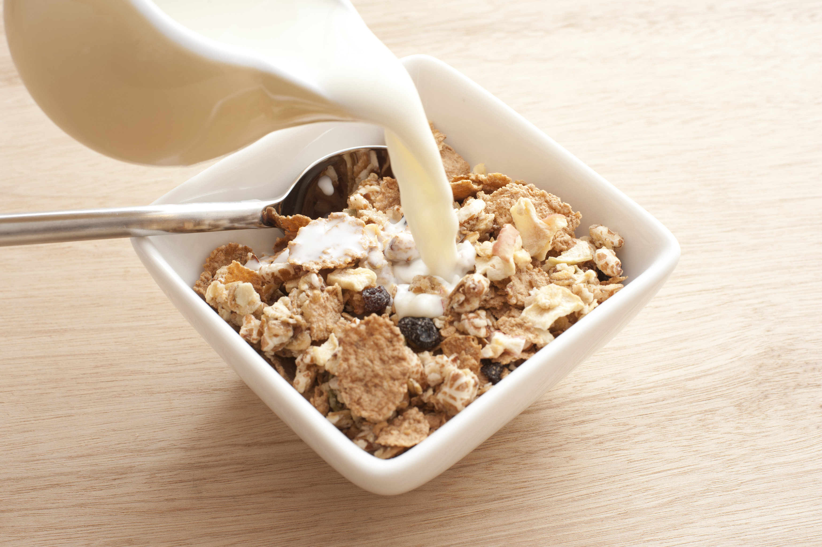
Daily Examples

Slide 6
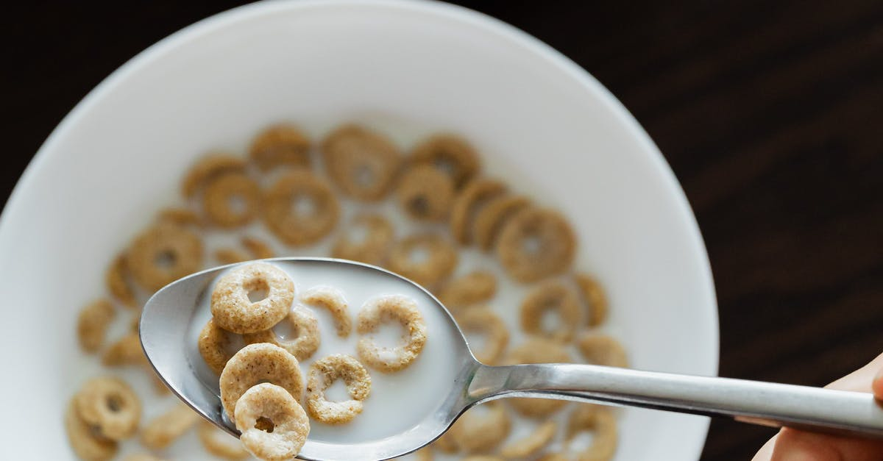
Heterogeneous Mixture
Heterogeneous means it has two or more substances BUT you can tell that there are different substances
Example: Cereal

Slide 7
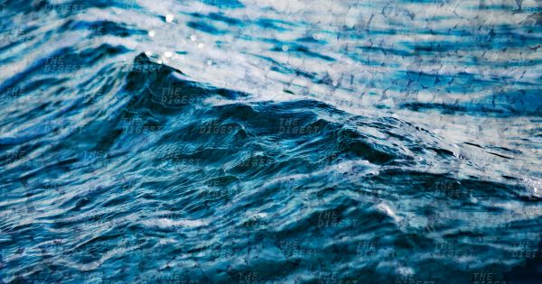
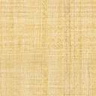
Homogeneous Mixture
Homogeneous mixtures have two or more substance BUT you CANNOT tell the difference in substances
This is a solution!
Example: saltwater

Slide 8
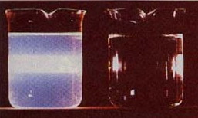
SOLUTIONS
Three key features:
Cannot see particles in a solution – example saltwater – cannot see the salt in the water
Liquid solutions will not cause a light beam to scatter
Solutions are only one phase at a time. (gas, liquid, solid)
Light scatters through first beaker therefore not a solution.

